Slide 2
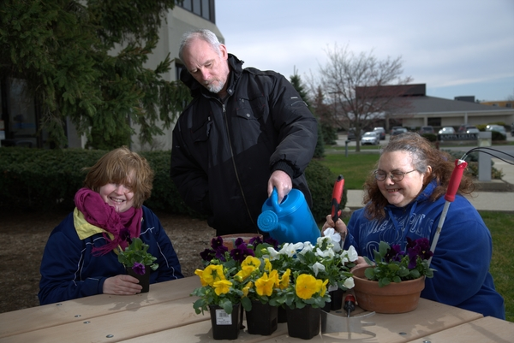
AKTION CLUB
Community service group composed of adults with disabilities
A program of Kiwanis International
One of 5 Service Leadership Programs of Kiwanis

Slide 3
AKTION CLUB
A program of Kiwanis International
Global organization dedicated to serving the children of the world
660,000 members in 80 countries
Raise US $100 million each year

Slide 4
AKTION CLUB
One of 5 Service Leadership Programs of Kiwanis
K-Kids: elementary students
Builders Club: middle school students
Key Club: high school students
Circle K: college students
Aktion Club: adults with disabilities

Slide 5
SERVICE LEADERSHIP
Definition:
BECOMING A LEADER THROUGH SERVIce to
OTHERS
Aktion Club video

Slide 6
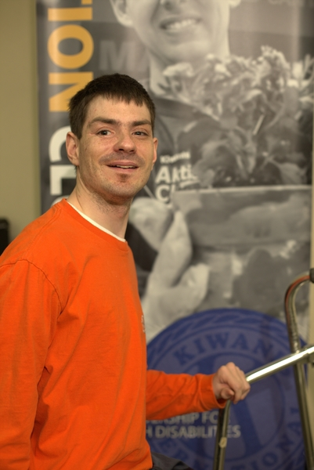
MISSION of Aktion Club
Develop initiative and leadership.
Serve the community.
Be an integral part of society.
Demonstrate the dignity and value of citizens living with disabilities

Slide 7
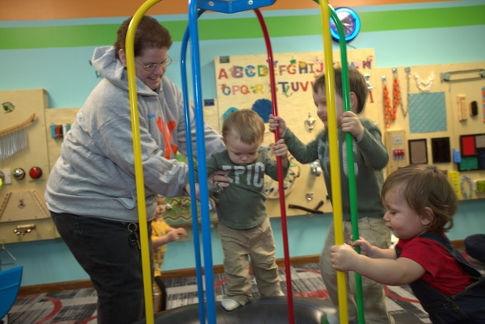
VISION of Aktion Club
To develop competent, capable, caring leaders through the vehicle of service

Slide 8
CORE VALUES of Aktion Club
Character Building
The ability to do the right think even when it might be the unpopular choice
Leadership
The ability to listen, communicate, serve and guide others
Inclusiveness
Accepting and welcoming differences in other people
Caring
The act of being concerned about or interested in other people or situations

Slide 9
AKTION CLUB HISTORY
First organized 1987 in Florida
Official program of Kiwanis International on October 1, 2000

Slide 10
AKTION CLUB STATS
USA
Canada
Austria
Australia
Aruba
Bahamas
Barbados
Columbia
Jamaica
Malaysia
Korea
Italy
Philippines
New Zealand
12,500 members
500+ clubs
14 countries

Slide 11
AKTION CLUB ACTIVITIES
CLUB MEETINGS
SERVICE PROJECTS
FUNDRAISING
SOCIAL ACTIVITIES
TRAINING AND LEADERSHIP CONFERENCES

Slide 12
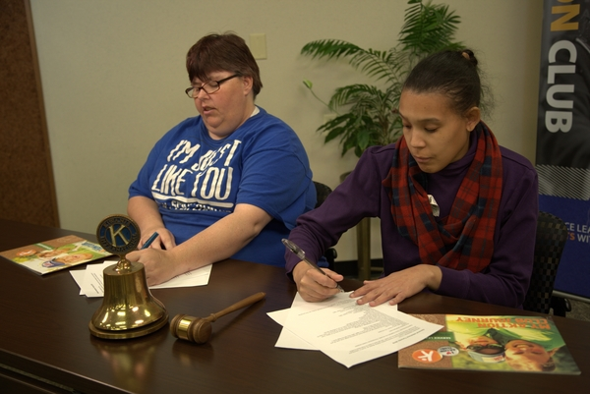
AKTION CLUB ACTIVITIES
CLUB MEETINGS
Scheduled 1-2 times per month
Business – planning events
Speaker – educational portion of meeting
Activity – service project, social event

Slide 13
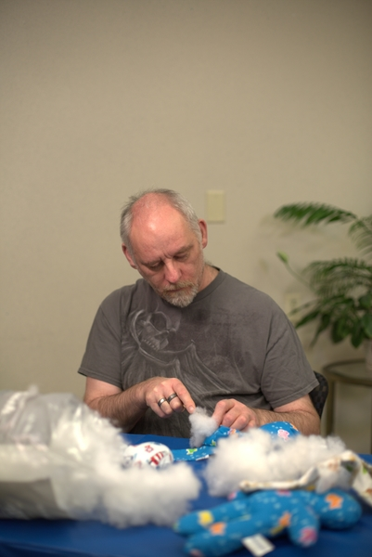
AKTION CLUB ACTIVITIES
SERVICE PROJECTS
Cards for military personnel
Nursing home visits
Park clean-up
Salvation Army bell-ringing
Create and donate Kiwanis dolls
Make fleece blankets for children’s hospitals

Slide 14
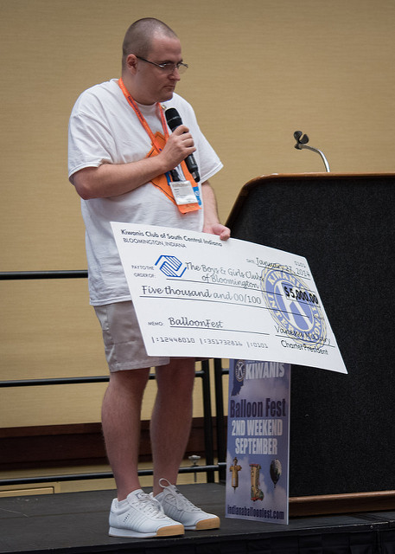
AKTION CLUB ACTIVITIES
Fundraising
Car washes
Fashion show
Creating and selling Christmas ornaments, calendars, cookbooks
Salvation Army bell ringing

Slide 15
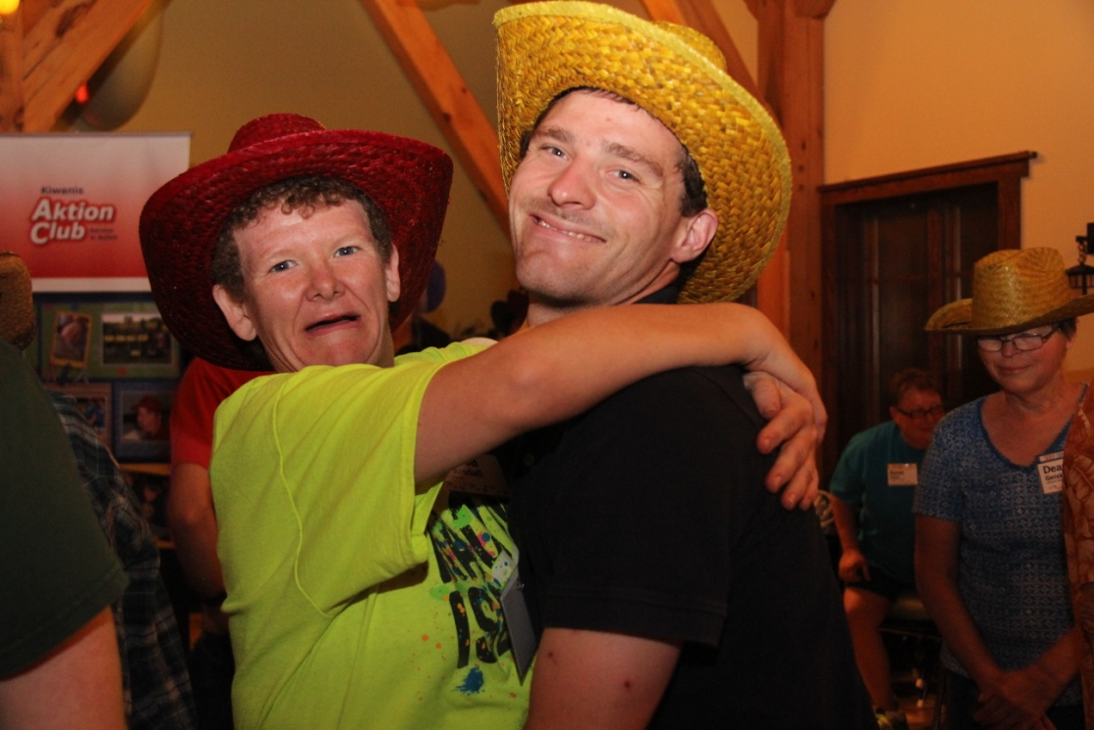
AKTION CLUB ACTIVITIES
Social Activities
Dances
Dinners
Sporting events
Concerts
Picnics
Camp

Slide 16
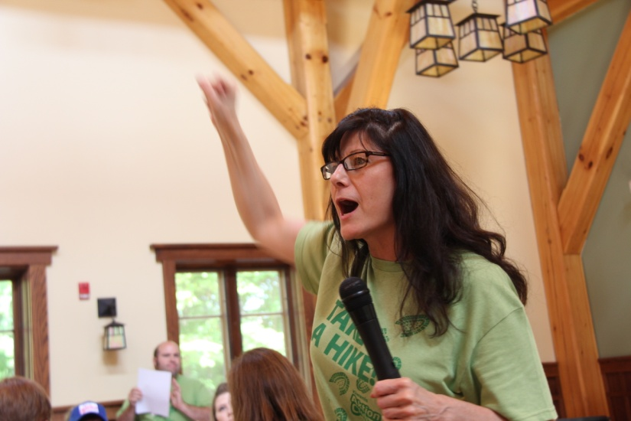
AKTION CLUB ACTIVITIES
Training and leadership conferences
Hosted by Kiwanis International
Different locations each year
Each event includes:
Leadership training for members
Club officer training
Service project
Social event
FUN!

Slide 17
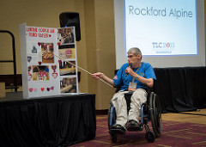
MEMBER BENEFITS
Building positive self-esteem
Development of initiative and leadership skills
Inclusion as active member of the community
Opportunity to develop meaningful friendships
Opportunity to better the community and world

Slide 18
WHO Can Sponsor an Aktion Club?
Kiwanis Club
Organizations working with people with disabilities

Slide 19
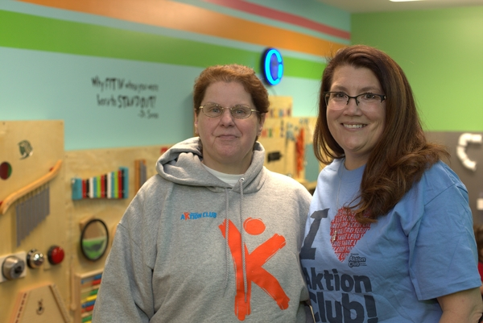
BENEFITS OF SPONSORSHIP
Personal growth and development
Create a more inclusive community
Provide opportunity to share talents
Provide opportunity to mentor members while engaging with their communities through service
Develop relationships that may last a lifetime
The list goes on and on…

Slide 20
BENEFITS TO THE COMMUNITY
Involved citizens helps a community grow
Creates an inclusive climate
Promotes acceptance
Breaks down barriers

Slide 21
HOW DO I START A CLUB?
3 Steps To Chartering a Club
Find: Find advisors, members and a place to meet.
Lead: Get organized, complete paperwork, train club leaders and build enthusiasm.
Serve: Reach out to the community and make a difference through meaningful service projects.

Slide 22
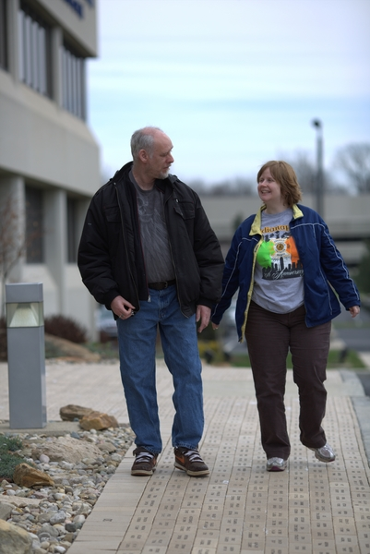
GET STARTED TODAY
Want more information?
www.aktionclub.org

Slide 23
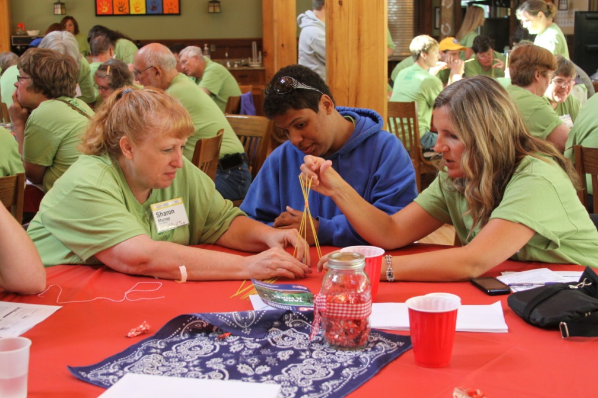
WHAT CAN AKTION CLUB MEMBERS DO?
ANYTHING!

Slide 24
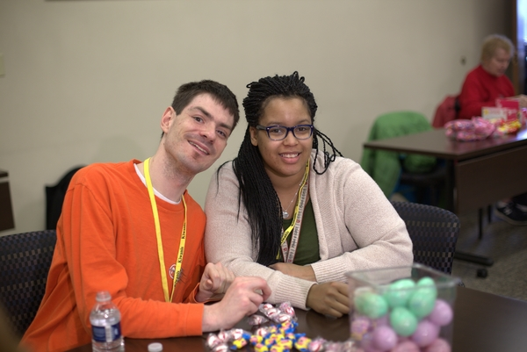
THANK YOU!

